Slide 1


Mobile development with Xamarin
Marco Minerva
https://about.me/marcominerva
@marcominerva
Riccardo Cappello
https://about.me/rcappello
@rcappello

Slide 2
What is native?
Notes:
Riccardo

Slide 3
Native User Interfaces
Native API Access
Native Performance

Slide 4

Xamarin’s unique approach
iOS C# UI
Android C# UI
Windows C# UI
Shared C# logic
Shared C# codebase • 100% native API access • High performance

Slide 5



Xamarin Native – Traditional UI
iOS C#
Android C#
Windows C#
Shared C# Logic
3 Native User Interfaces
Shared App Logic

Slide 6


Xamarin.Forms – Cross Platform UI
Shared UI Code
Shared C# Logic
Shared Native User Interface
Shared App Logic

Slide 7
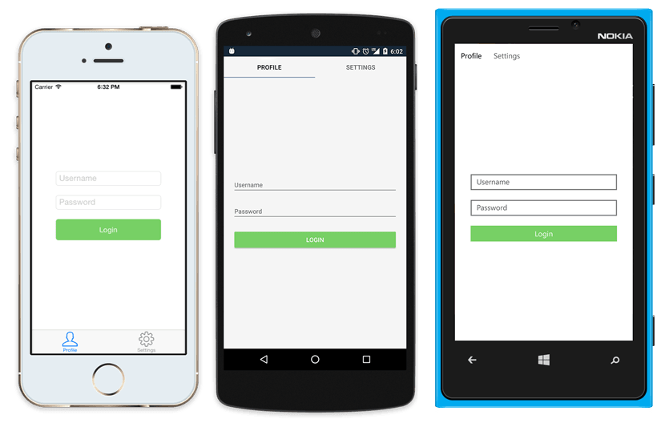
Xamarin.Forms in a nutshell
<?xml version="1.0" encoding="UTF-8"?>
<TabbedPage xmlns="http://xamarin.com/schemas/2014/forms"
xmlns:x="http://schemas.microsoft.com/winfx/2009/xaml"
x:Class="MyApp.MainPage">
<TabbedPage.Children>
<ContentPage Title="Profile" Icon="Profile.png">
<StackLayout Spacing="20" Padding="20"
VerticalOptions="Center">
<Entry Placeholder="Username"
Text="{Binding Username}"/>
<Entry Placeholder="Password"
Text="{Binding Password}"
IsPassword="true"/>
<Button Text="Login" TextColor="White"
BackgroundColor="#77D065"
Command="{Binding LoginCommand}"/>
</StackLayout>
</ContentPage>
<ContentPage Title="Settings" Icon="Settings.png">
<!-- Settings -->
</ContentPage>
</TabbedPage.Children>
</TabbedPage>

Slide 8
Xamarin Platform is
included in Visual Studio
Including Community Edition
Notes:
Including the Free Community Edition

Slide 9

Open Source – open.xamarin.com

Slide 10
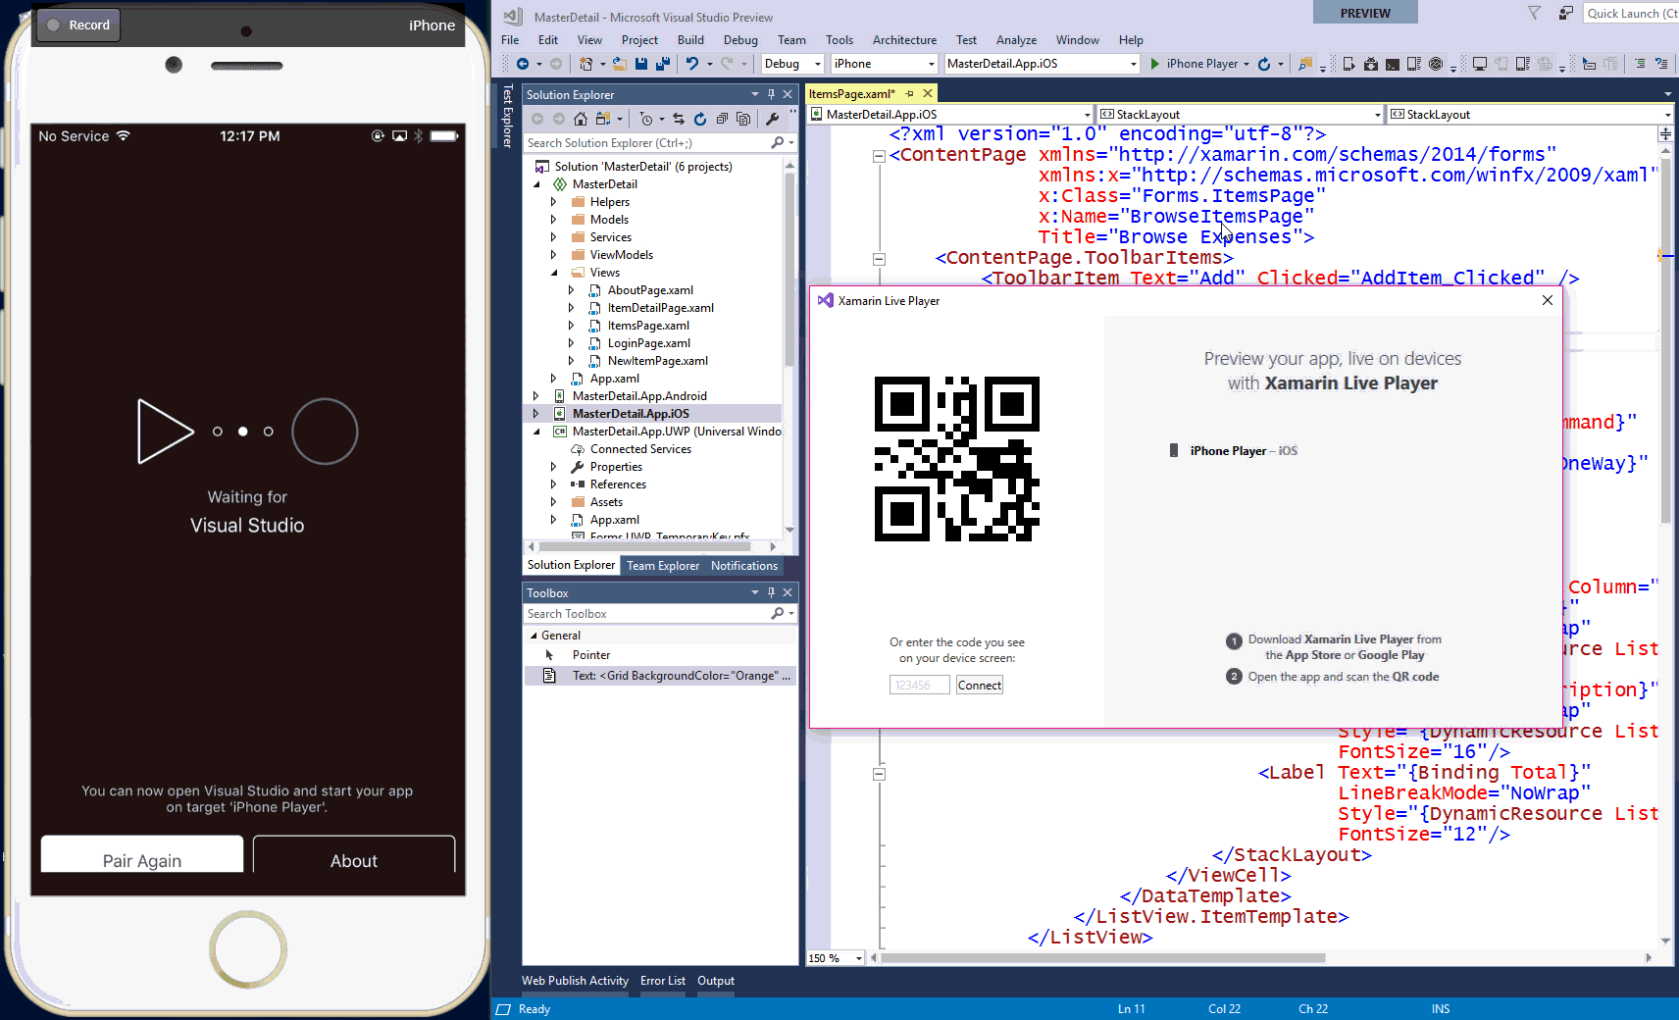
Xamarin Live Player
Notes:
DEMO

Slide 11
Demo
Xamarin End-to-End

Slide 12
Simplifying Development & Sharing More Code

Slide 13

.NET
Everywhere
Device native
.NET
Cloud native
.NET Everywhere
.NET STANDARD LIBRARY

Slide 14
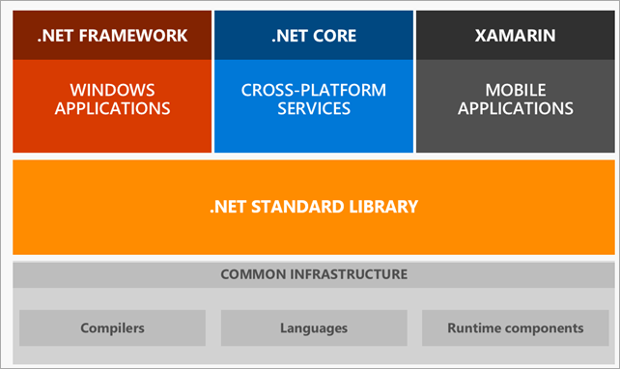
.NET Standard

Slide 15
Shared C# Backend

Slide 16
Plugins for Xamarin & Windows
Xamarin.com/plugins
Common API

Slide 17
Demo
Xamarin Plugins
From Portable Class Libraries to .NET Standard

Slide 18
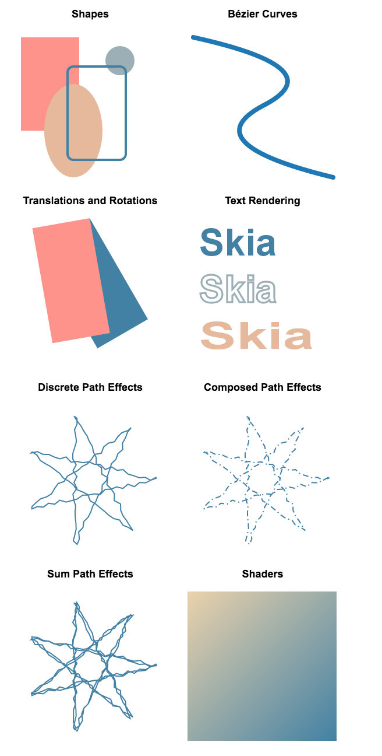

2D Graphics Library
SkiaSharp
The 2D graphics engine
Powers Google Chrome and Android.
Cross platform: Android, iOS, Mac, UWP, tvOS, Windows
Comprehensive
Image loading and saving
Immediate composited rendering mode
GPU accelerated (where available/enabled)
Custom effects and shaders
SVG Loading
http://aka.ms/skiasharp
Shapes
Bézier Curves
Translations & Rotations
Text rendering
Discrete Path Effects
Composed Path Effects
Sum Path Effects
Shaders

Slide 19


Xamarin & Xamarin.Forms ecosystem

Slide 20
Xamarin + Xamarin.Forms
iOS C# UI
Android C# UI
Windows C# UI
Xamarin.Forms
Shared C# Logic
Shared C# Logic
Traditional Xamarin approach
With Xamarin.Forms: More code-sharing, all native

Slide 21

New Platforms
Samsung Tizen
Televisions, Wearables, Mobile
macOS
WPF
Linux: GTK#

Slide 22
Embedding
https://blog.xamarin.com/unleashed-embedding-xamarin-forms-in-xamarin-native
Works on ContentPages
Full support for DependencyService and MessagingCenter
Xamarin.Forms
iOS C#
Android C#
Windows C#
Shared C# Logic

Slide 23
Demo
Xamarin with Visual Studio for Mac

Slide 24

Free self-guided courses
Take free self-guided courses that cover the core Xamarin concepts and count towards certification.
Register at university.xamarin.com/self-guided
Get a full subscription for live classes, advanced topics, and to complete certification.
Sign up at
xamarin.com/university

Slide 25
Thank you.
DotNetToscana
Dotnettoscana.org
Marco Minerva
Microsoft MVP – Windows Development
Riccardo Cappello
Microsoft MVP – Microsoft Azure

